Slide 1
3-SAT Problem Solving using AI Search Algorithms
MindMesh
Members :
Punnam Maakhish Sai B221135CS
Bavusani Mithilesh Reddy B220768CS
Kranti Sambhav B220970CS
Hande Rajat Santosh B220891CS

Slide 2
Problem Statement
3-SAT (3-Satisfiability) is a classic NP-Complete problem in computational complexity. It is a special case of the Boolean Satisfiability (SAT) problem, where the goal is to determine if a Boolean formula can be satisfied by some assignment of truth values.
The formula is expressed in Conjunctive Normal Form (CNF), i.e., an AND of clauses, where each clause is an OR of literals. In 3-SAT, each clause contains exactly three literals.
The task is to check whether there exists an assignment of true/false values to the variables such that the entire 3-CNF formula evaluates to true.

Slide 3
Objectives
• Implement multiple AI search algorithms to solve 3-SAT.
• Compare performance of uninformed (BFS) vs informed (Best-FS, A*, Hill Climbing).
• Analyze trade-offs in speed, completeness, and memory usage.

Slide 4
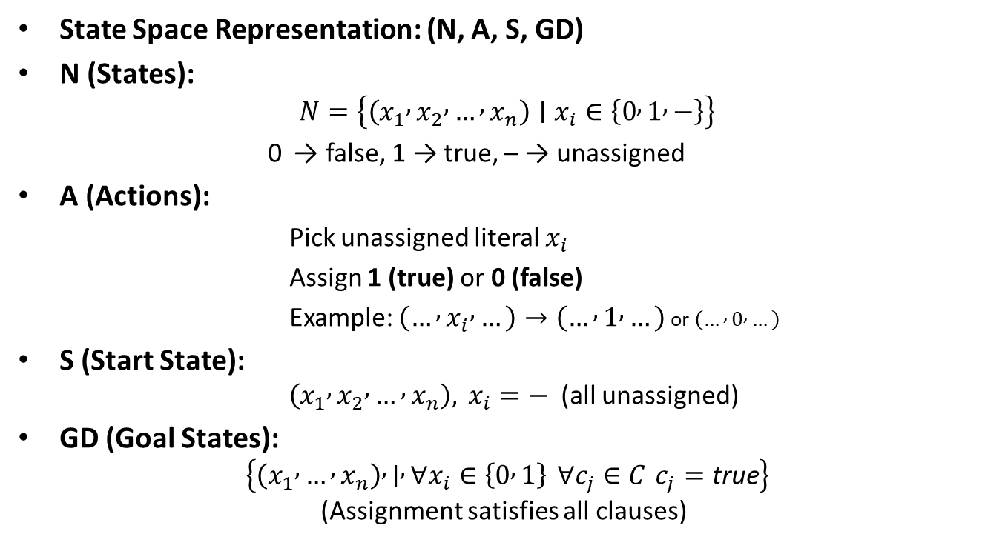
State Space Representation
State Space Representation: (N, A, S, GD)
N (States): $N=\left\{\left(x_{1} , x_{2} , … , x_{n}\right)∣x_{i}∈\left\{0 , 1 , −\right\}\right\}$
0 → false, 1 → true, – → unassigned
A (Actions):
Pick unassigned literal $x_{i}$
Assign 1 (true) or 0 (false)
Example: $\left(… , x_{i} , …\right)→\left(… , 1 , …\right)$ or $\left(… , 0 , …\right)$
S (Start State): $\left(x_{1} , x_{2} , … , x_{n}\right), x_{i}=−$(all unassigned)
GD (Goal States): $\left\{\left(x_{1} , … , x_{n}\right) , ∣ , ∀x_{i}∈\left\{0 , 1\right\} ∀c_{j}∈C c_{j}=\text{true}\right\}$ (Assignment satisfies all clauses)

Slide 5
Algorithm Overview
BFS – Explores level by level, complete but slow, very high space/time.
Best-First Search – Uses heuristic (unsatisfied clauses), faster but may get stuck in local minima.
Hill Climbing – Local search with iterative improvement, simple but incomplete without random restarts.
A* – Cost = g(n) + h(n); combines optimality with heuristics, efficient but memory-intensive.

Slide 6
BFS Approach
Algorithm Behavior
Explores the search tree level by level.
Starts with an empty assignment, then branches by assigning each unassigned variable → {True, False}.
Uses a queue to manage states → ensures completeness.
Returns the first satisfying assignment found.

Slide 7
BFS Approach
Time Complexity : O(2^n)
All possible assignments of n variables may be generated.
Space Complexity : O(2^n)
Because BFS stores all frontier nodes (assignments at each level).
Performance :
BFS does not use heuristics → explores all states systematically.
Strength: Guarantees finding a solution if one exists (complete).
Weakness: Memory blow-up, exponential runtime.

Slide 8
Best First Search Approach
Algorithm Behavior
Uses a priority queue to expand the node with the lowest heuristic cost first.
Heuristic = number of unsatisfied clauses (lower is better).
Expands assignments that “look promising” instead of exploring level by level.
Stops once a complete satisfying assignment is found.

Slide 9
Best First Search Approach
Time Complexity
Worst case : O(2^n)
Average case : O(b^d), where b is branching factor (≈ 2) and d is solution depth. Much faster than BFS.
Space Complexity
Average case : O(2^n)
Performance vs Heuristics
Heuristic-driven : Faster than BFS if heuristic is accurate.
Strength : Prioritizes promising assignments → efficient search.
Weakness : Not guaranteed optimal in terms of solution depth.

Slide 10
Hill Climbing Approach
Algorithm Behavior
Starts with a random assignment of variables.
Iteratively flips a variable that reduces the number of unsatisfied clauses.
Stops if no improvement is possible (local maximum) or a satisfying assignment is found.
Uses random restarts to escape local maxima.

Slide 11
Hill Climbing Approach
Time Complexity
With up to R random restarts: O(R⋅n⋅k), where k = iterations per restart.
Worst Case: Exponential (if unlucky restarts). In our case, R = 10, which limits the restarts.
Space Complexity
Stores only the current assignment : O(n)
Performance
Strengths:
Very low memory usage and fast with random restarts.
Weaknesses:
Can get stuck in local minima / plateaus.
May fail even if solution exists.

Slide 12
A* Search Approach
Algorithm Behaviour
- Maintains states with g(n) + h(n) where:
g(n) = cost so far (assigned variables).
h(n) = heuristic (# unsatisfied clauses).
Expands the state with the lowest f(n) first.
Guarantees optimal solution if heuristic is admissible.

Slide 13
A* Search Approach
Time Complexity
At most explores all possible assignments : O(2^n)
With a good heuristic, prunes large parts of the search space.
Space Complexity
Must store all frontier nodes in priority queue.
Complexity is potential exponential : O(2^n)
Performance
Strengths:
Complete and Optimal (with admissible heuristic).
Weaknesses:
Memory-intensive due to large frontier.
Slower for large n if heuristic is weak.

Slide 14
Performance Metrics
Formula to be evaluated :
( x₁ V ¬x₂ V x₃ ) ^ ( ¬x₁ V x₄ V ¬x₅ ) ^ ( x₂ V ¬x₃ V x₆ ) ^ ( ¬x₄ V x₅ V ¬x₆ ) ^
( x₁ V ¬x₃ V x₅ ) ^ ( ¬x₂ V x₄ V x₆ ) ^ ( x₃ V ¬x₅ V ¬x₁ ) ^ ( x₆ V ¬x₂ V x₄ ) ^
( ¬x₁ V x₅ V ¬x₆ ) ^ ( x₂ V ¬x₄ V x₃ )
Metrics used for performance analysis of algorithms :
Time complexity
Space complexity
Nodes explored
Time taken to run

Slide 15
Heuristics
Tried h1(n): #unsatisfied clauses → simple but weak.
Adopted h2(n): Minimum extra assignments needed to satisfy all clauses.
Why h2 works better:
Tighter lower bound on cost.
Detects dead-ends earlier.
Reduces node expansions → faster overall.
Trade-off:
Slightly higher per-node cost, but outweighed by big search-space reduction.
Gave best balance between worst-case O(2^n) and practical runtime.

Slide 16
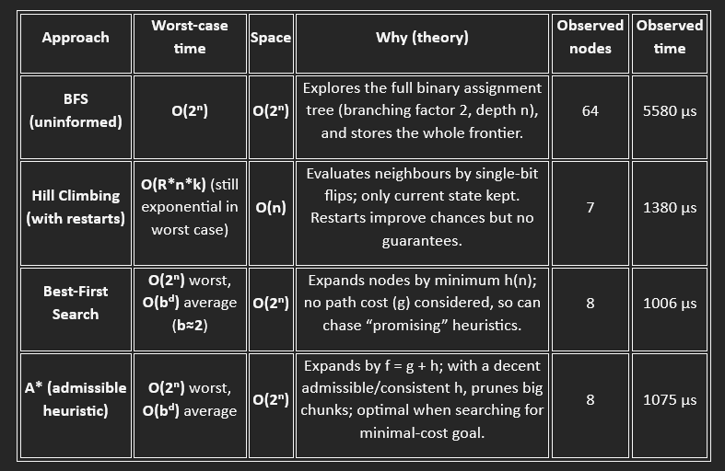
Performance Analysis

Slide 17
Conclusion
Brute-force BFS is infeasible — huge search space and time.
Hill Climbing is efficient in space/time but risks local optima.
Best-First Search is faster but shortsighted (ignores path cost).
A* with a well-chosen admissible heuristic (h2) balances exploration and pruning:
- Cuts down unnecessary expansions.
- Achieves near-optimal runtime without excessive overhead.
Takeaway: Heuristics make all the difference — with the right design, A* delivers the best practical performance on SAT search.

